Slide 1


ASSOCIATION FOR COMPUTING MACHINERY
INTRODUCTION TO
WEB DEVELOPMENT
GITHUB & HTML/CSS
Notes:
Deric

Slide 2
Github
Download “Github Desktop”
Sign in the account you created through the program.
Click on “Add” & “Create New Repository”.
Name the repository what you named your folder.
The description is optional.
Click on “Choose…”
For the local path, make sure you set the path to the parent of the folder.
Click on “Create Repository”.
Next, “Publish Repository”.
Unselect “Keep this code private”.
Click on “Create Repository” again.
Notes:
Deric

Slide 3
Tracking Your Progress
Go to “github.com” & locate your repository that you just created.
Copy the URL of your repository.
Paste your repository URL in “#wedev-discussion”
Before you send it, please also include your full name in the message.
If we don’t receive a message from you containing your repository, we will assume that you didn’t show up to our second workshop and have a chance of being removed from our roster.
Please let us know if you have any problems regarding this project.
Notes:
Member Goals:
Download Visual Studio Code
Download Github Desktop
Create an account on Discord
Post their Repository URL on the #lowerclassmenprojects
Create Folder Structure
Create their first html file

Slide 4
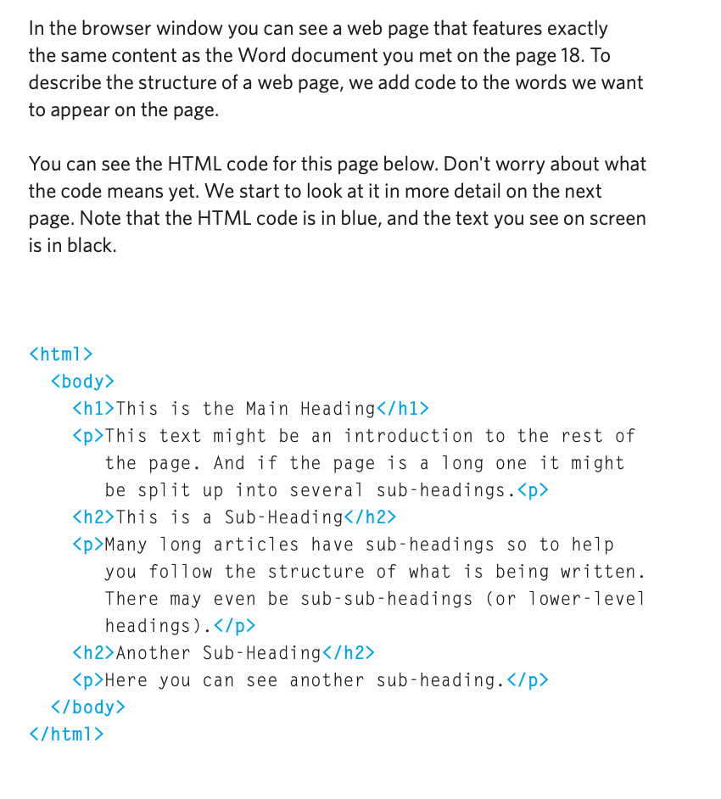
HTML
the standard markup language for creating web pages and web applications.
It’s basically a text document, but on special tags/elements.
No, HTML isn’t a programming language.
It’s a MARKUP Language.
It represents structured data, therefore there’s no algorithms.

Slide 5
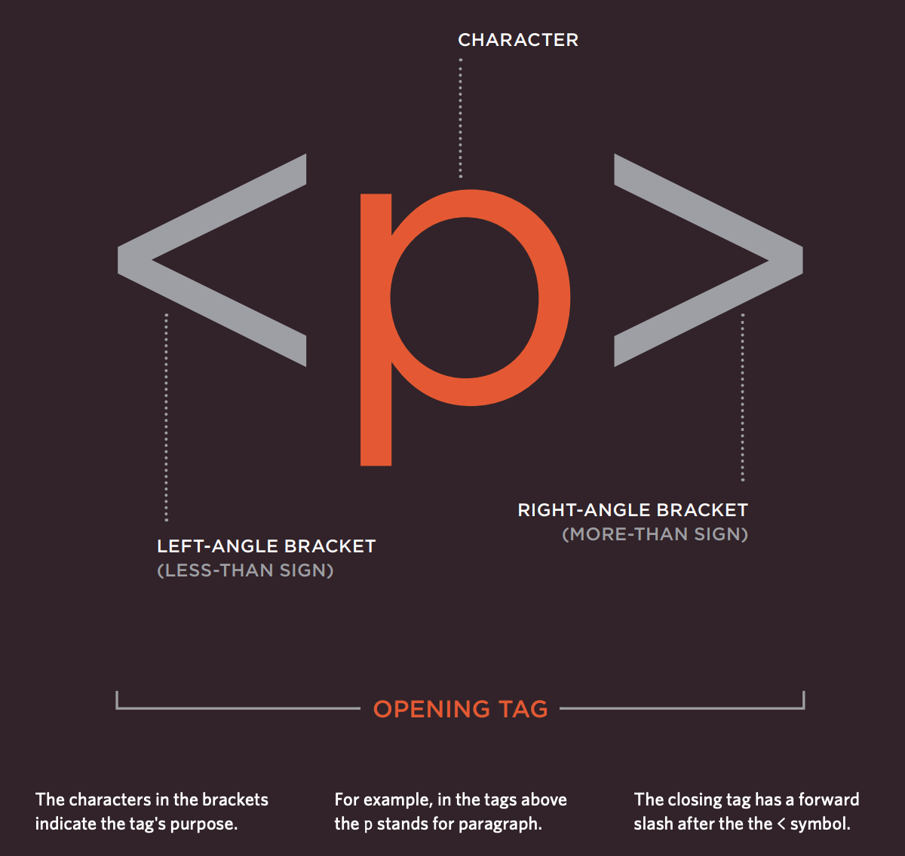
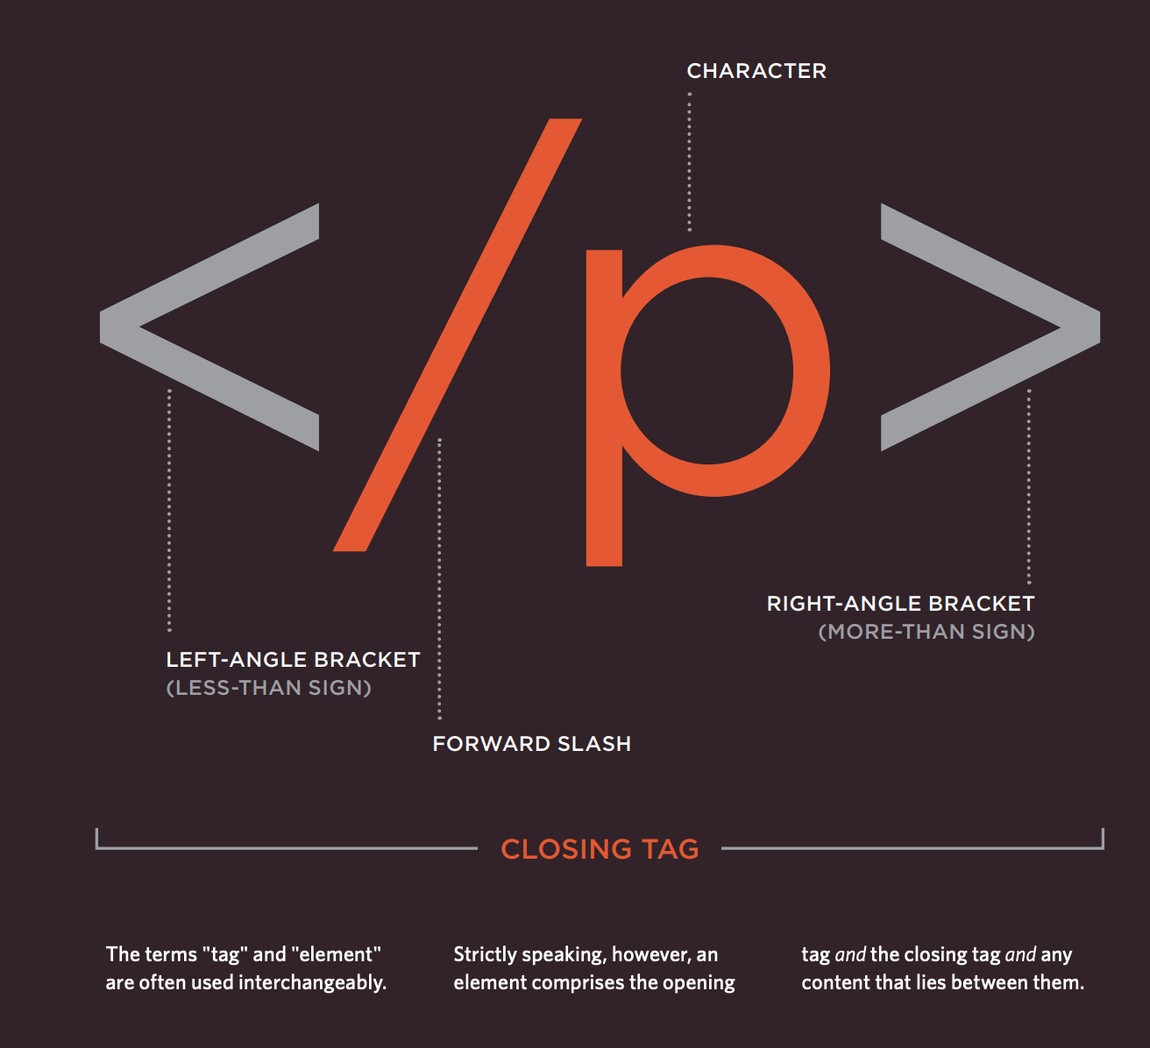
TAGS

Slide 6
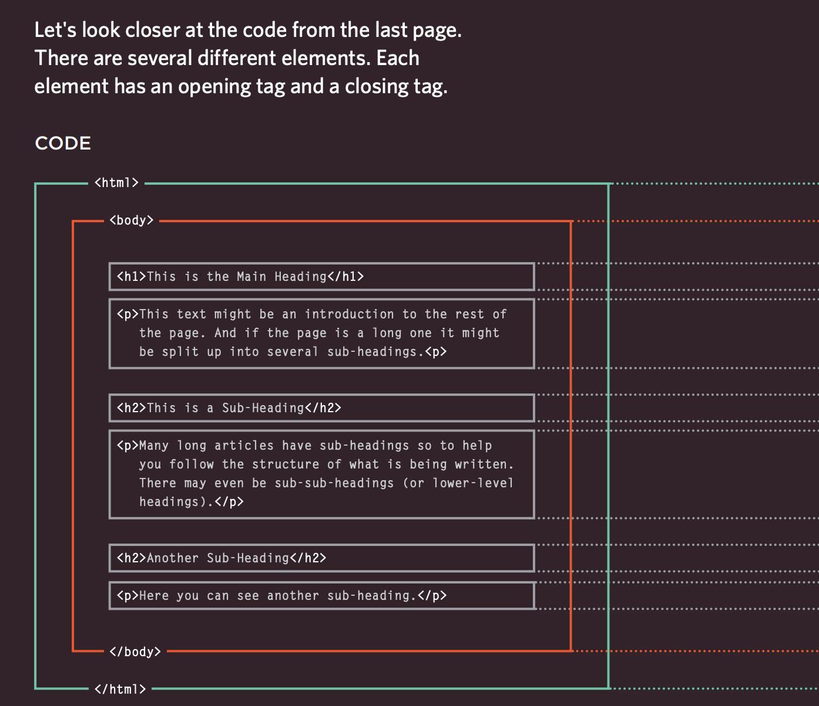
ELEMENTS
An opening tag and closing tag makes up a element.

Slide 7
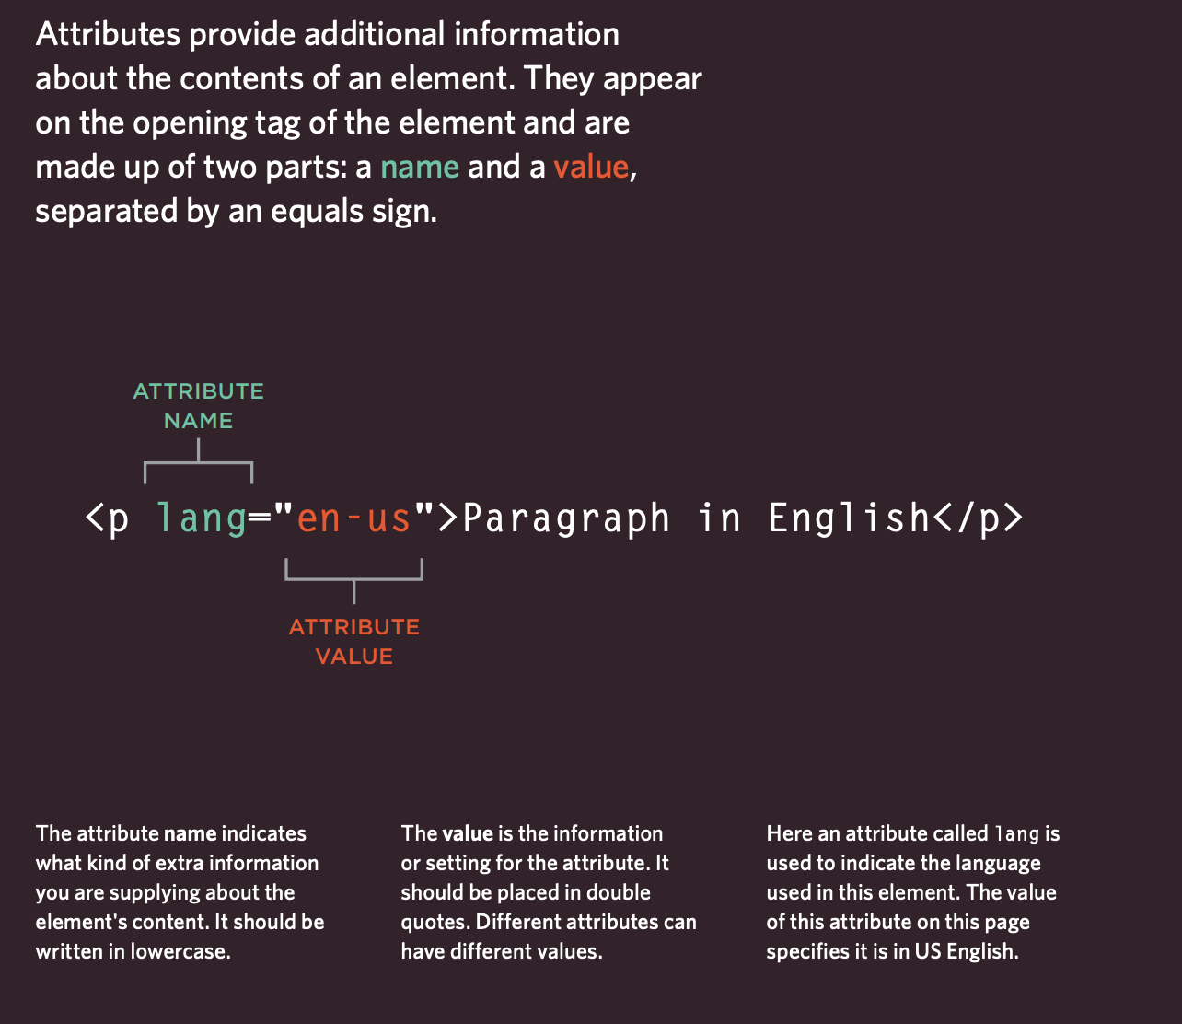
ATTRIBUTES
Really useful for CSS and javascript.
Used commonly for naming your elements.

Slide 8
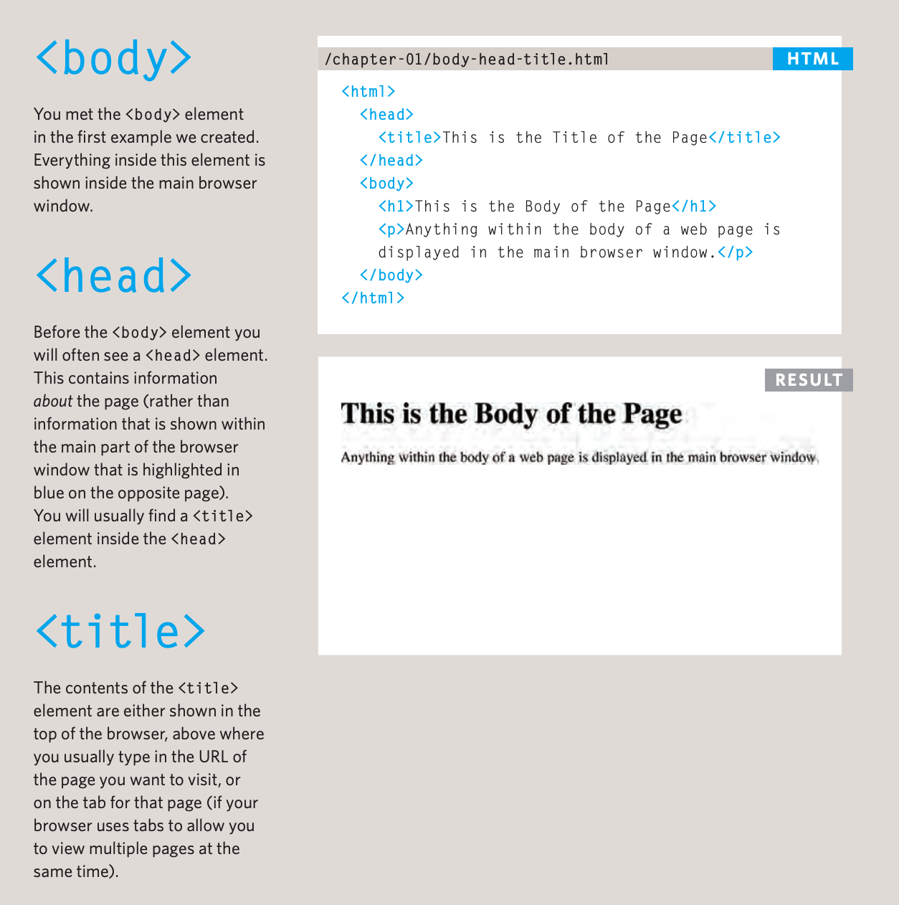
STRUCTURE
Allows you to organize your document.
It’s require that you structure, but it does work even if you don’t structure it correctly.
There’s no such thing as errors in HTML.

Slide 9
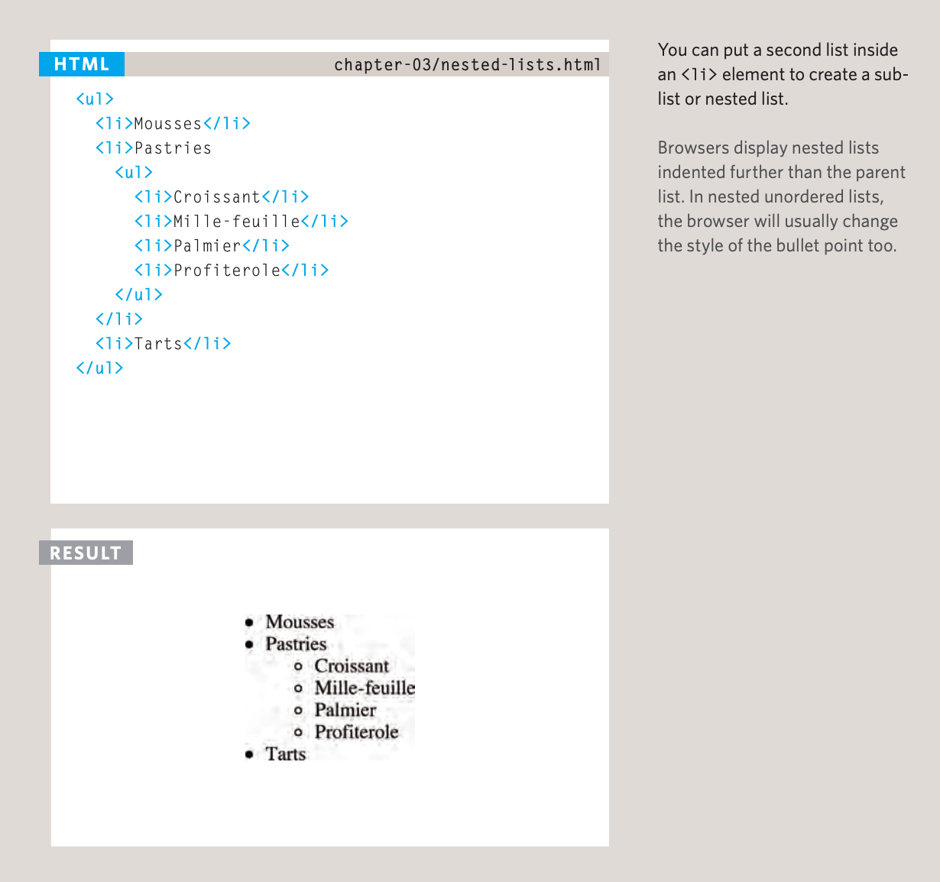
LISTING

Slide 10
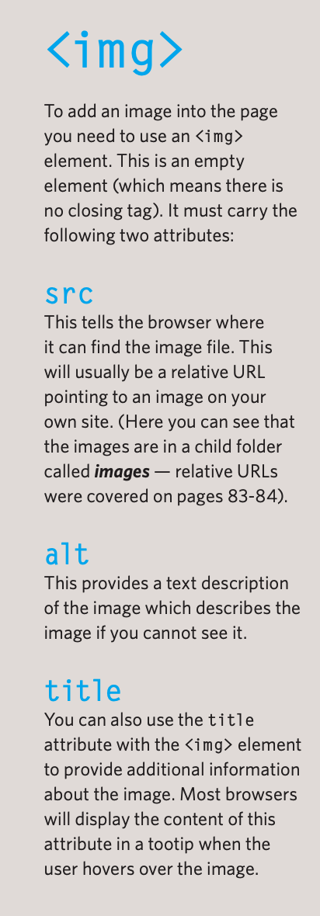
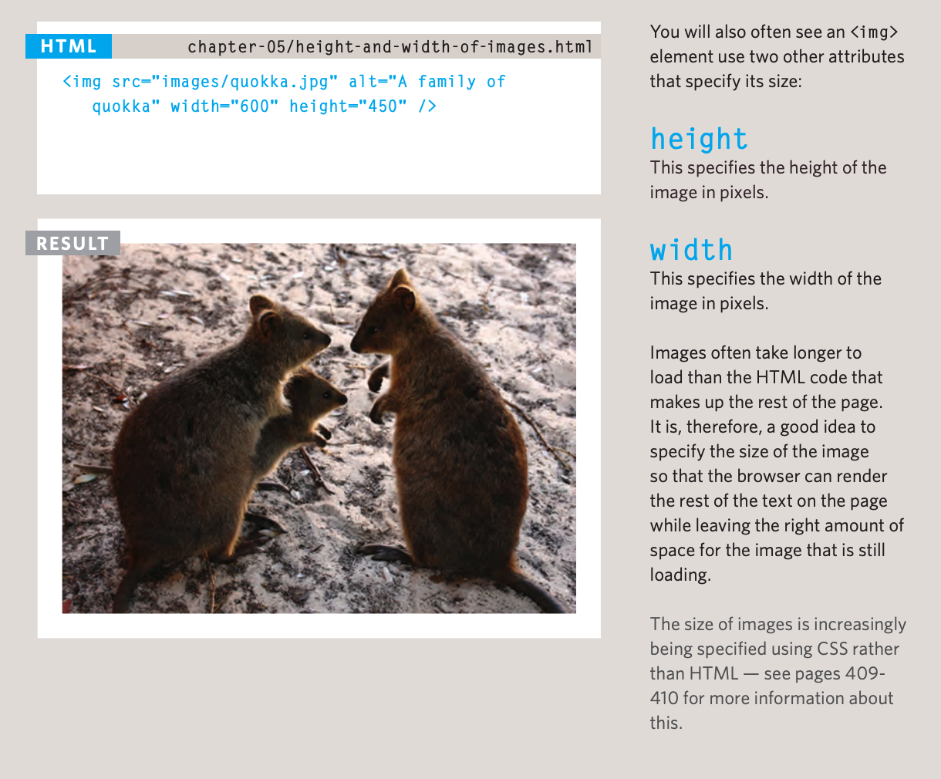
IMAGES

Slide 11
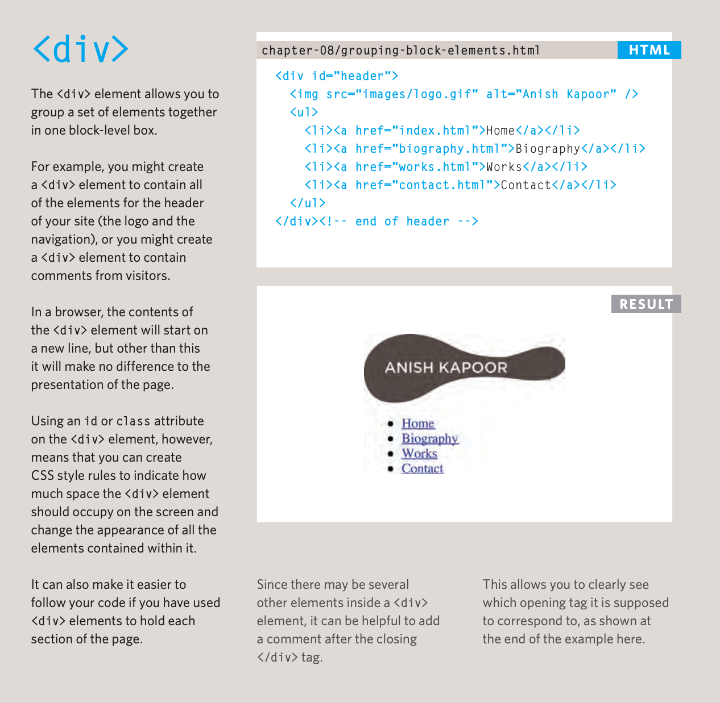
GROUPING

Slide 12
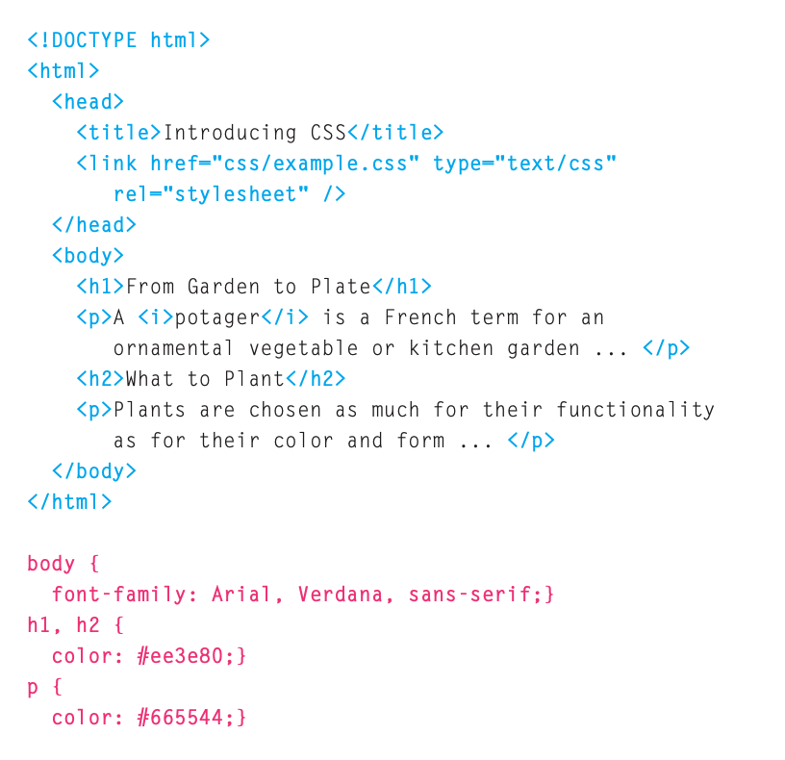
CSS
Can’t be used independently without HTML.
Responsible for the design or style of the website, including the layout, visual effects and background color.

Slide 13
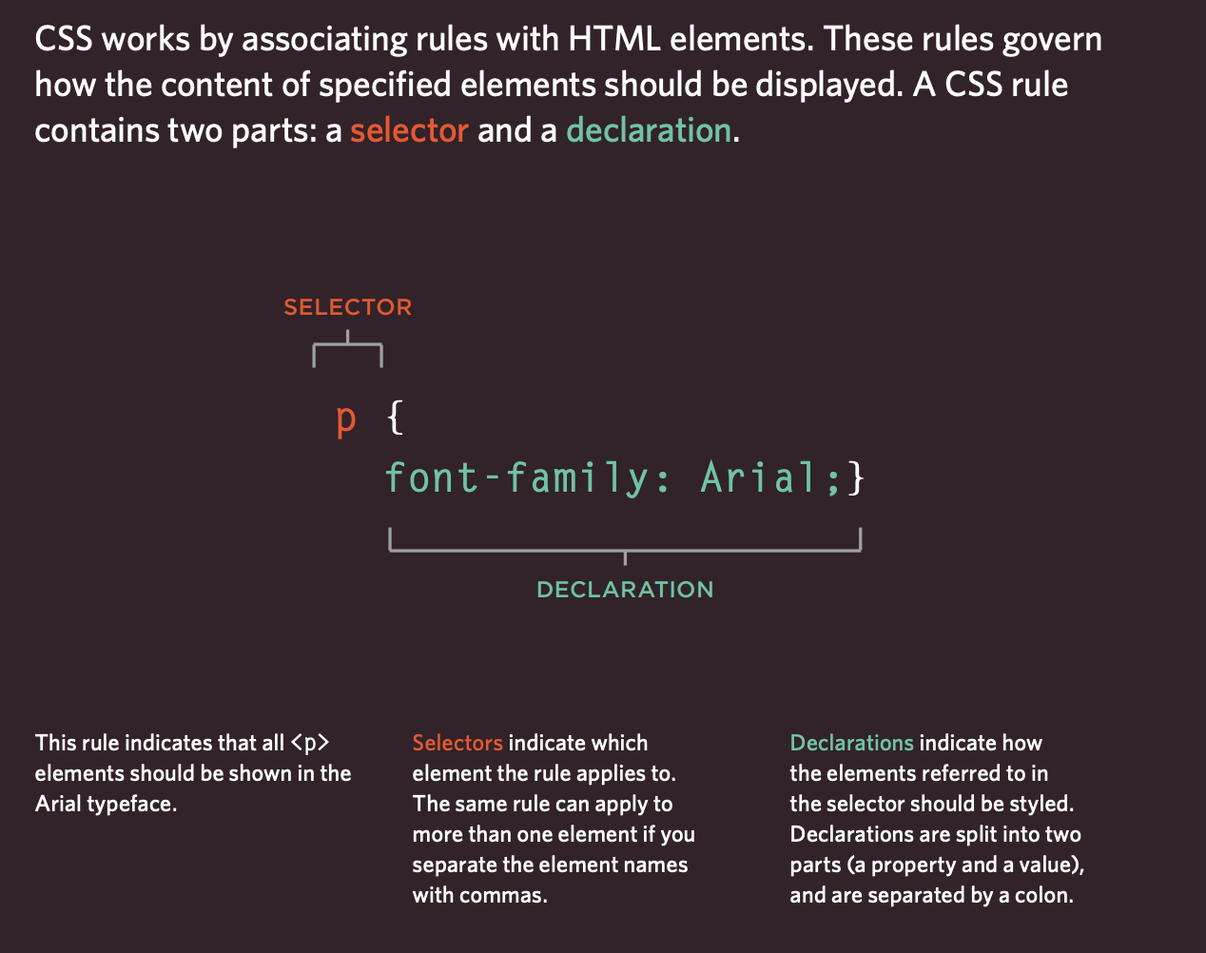
SELECTOR

Slide 14
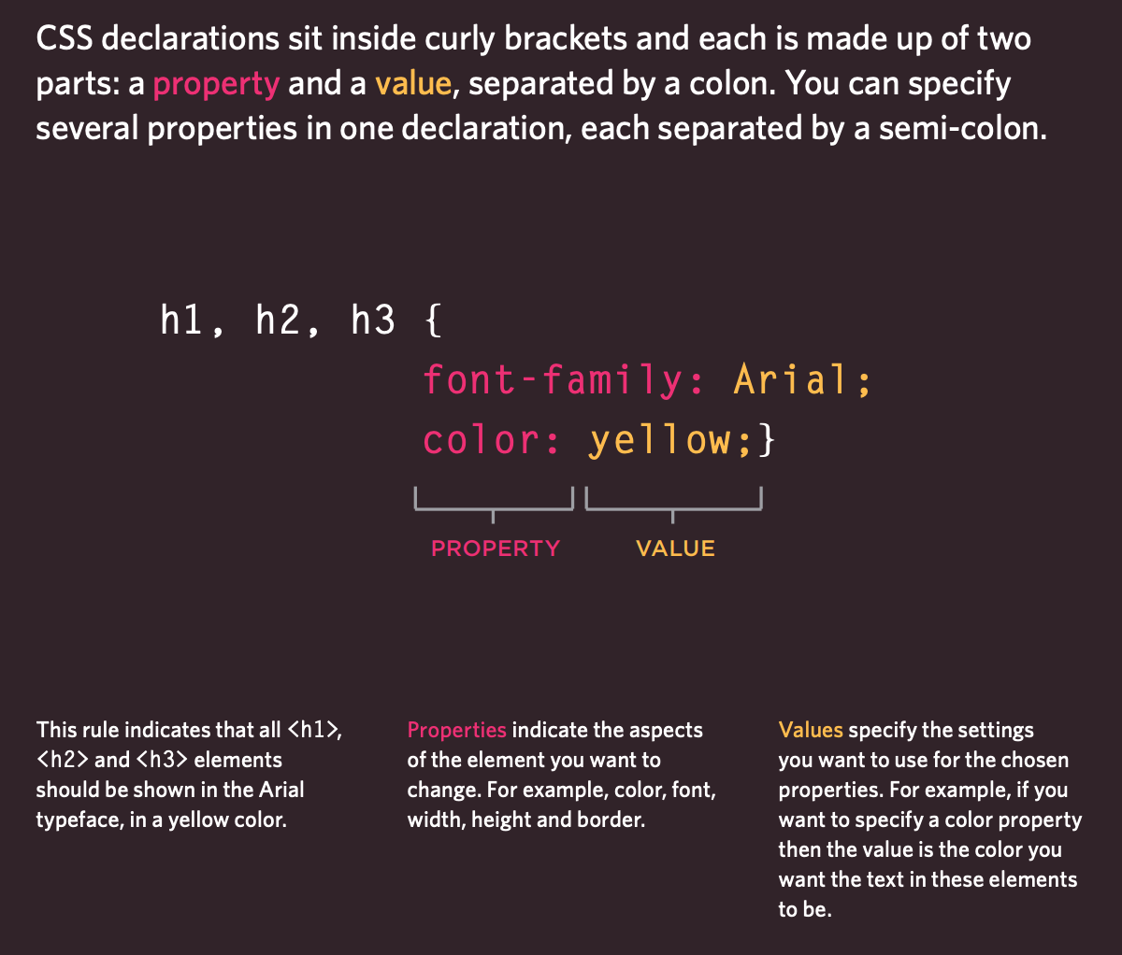
DECLARATION

Slide 15
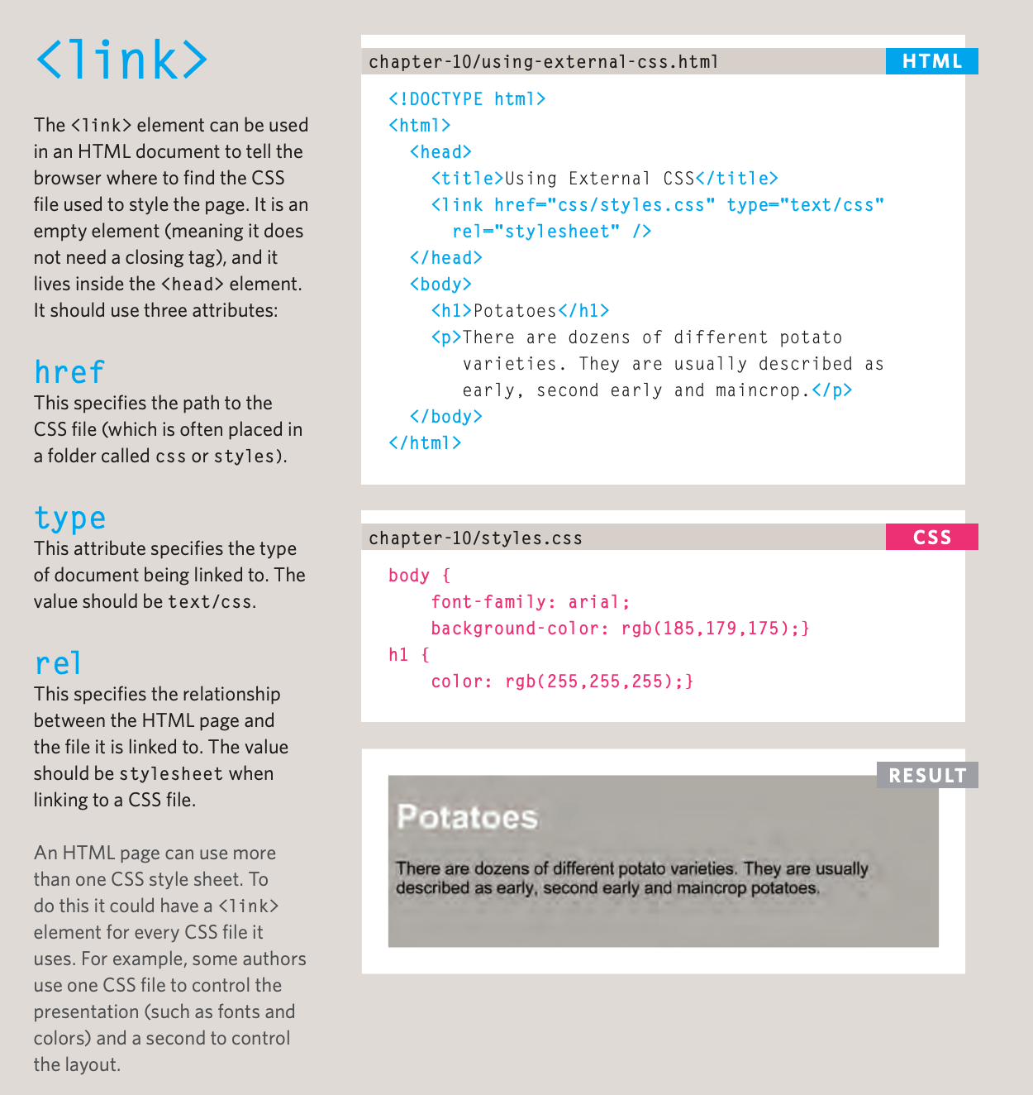
USING EXTERNAL CSS

Slide 16
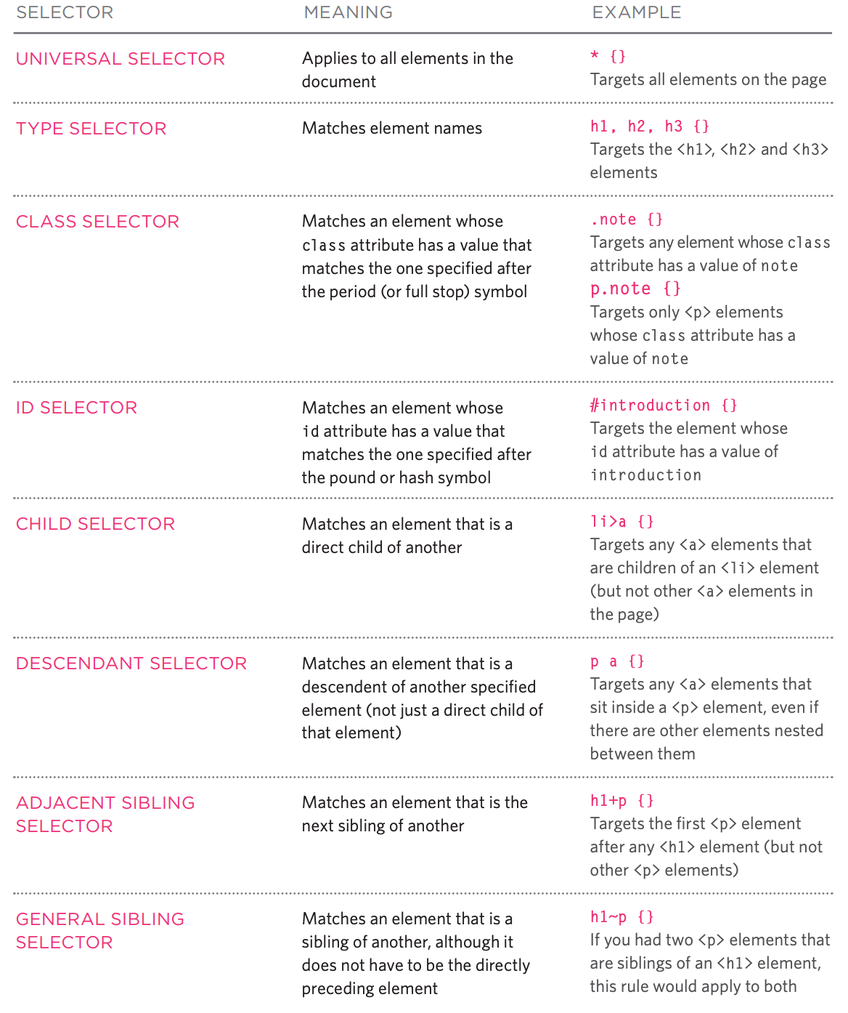
SELECTORS
REFERENCE

Slide 17
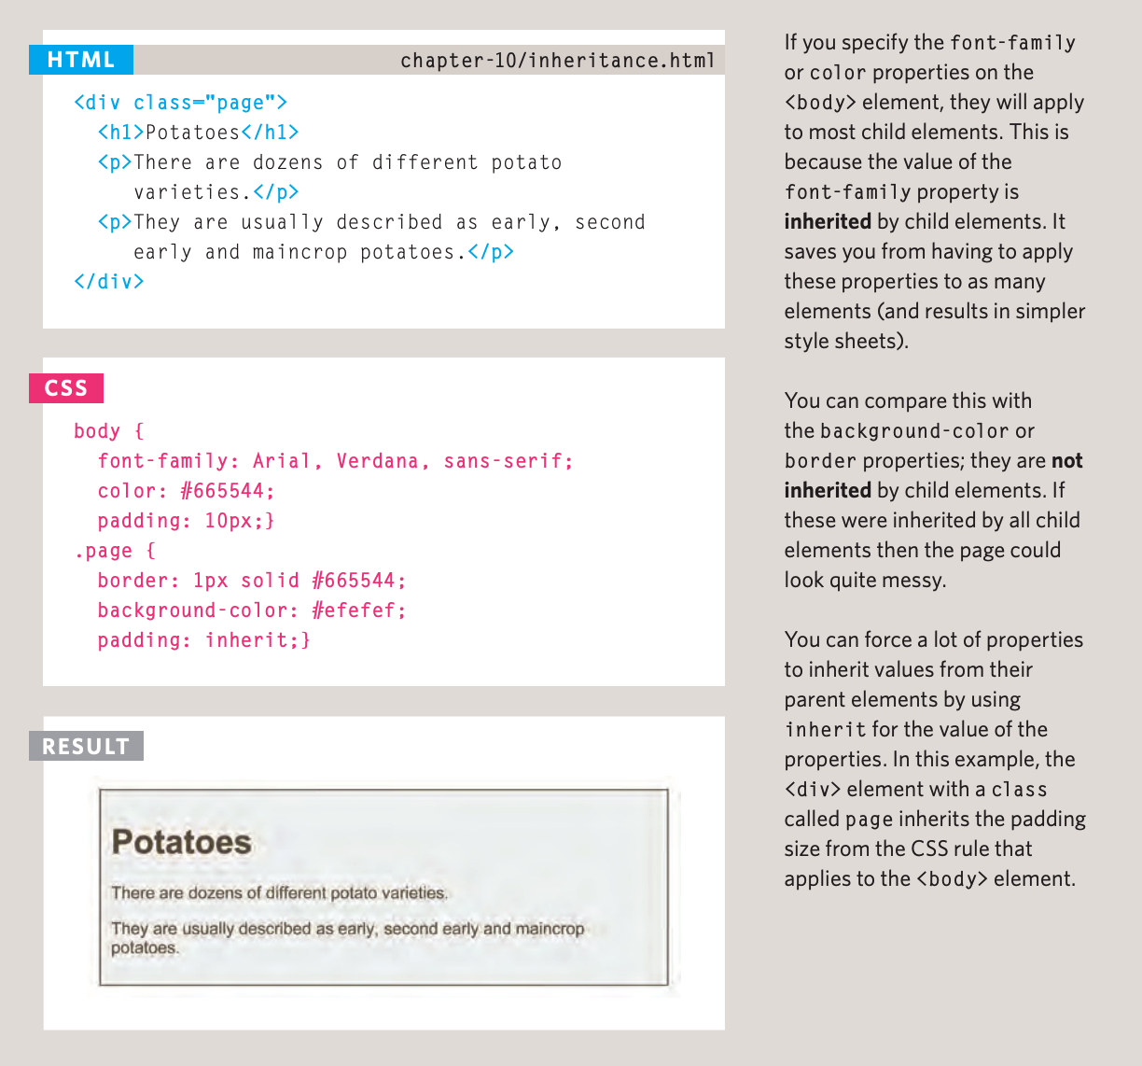
INHERITANCE

Slide 18
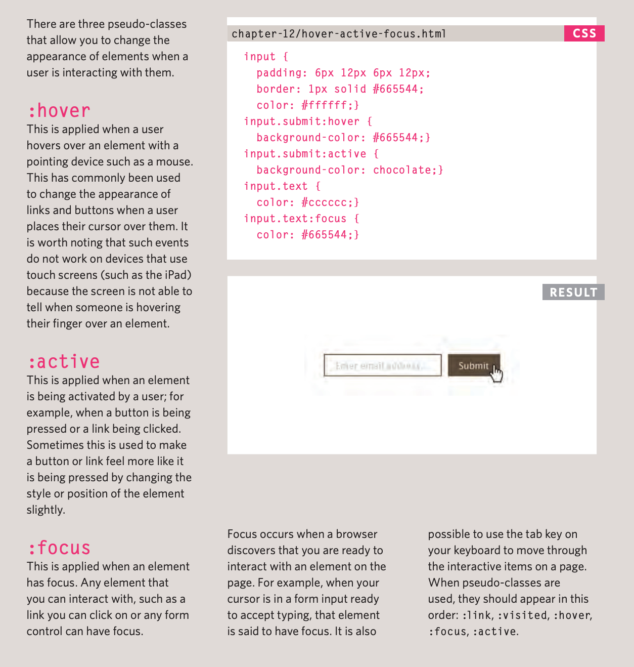
RESPONDING TO USERS
Notes:
Members Goals:
By the next workshop, they should have finish their about.html & moving on to their resume/portfolio pages.
In the about.html, they should have:
Navbar
A Picture of their self.
Use google fonts
Choose a color palette.

